Slide 1
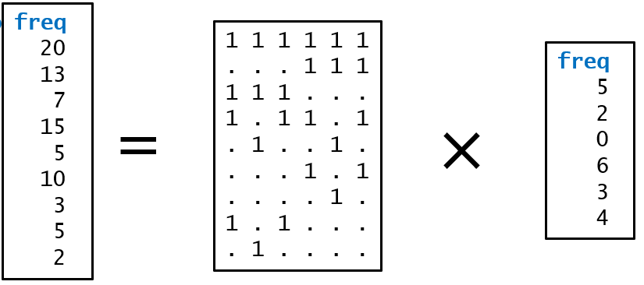
Statistical Disclosure Control (SDC) day 5, part 1
Microdata or frequency data
Advanced hierarchy examples
Theory: What happens from input to output?
Structural zeros
04.03.2024

Slide 2
Contents
Microdata or frequency data
Advanced hierarchy examples
which is also the preamble to structural 0’s
Theory: What happens from input to output?
Structural zeros
Key lessons for formula interface users
The content is mainly relevant for frequency tables

Slide 3
Microdata or frequency data

Slide 4
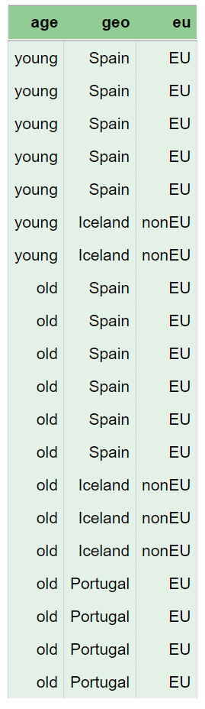
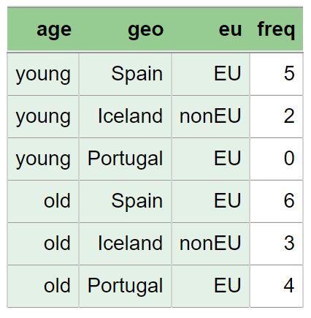
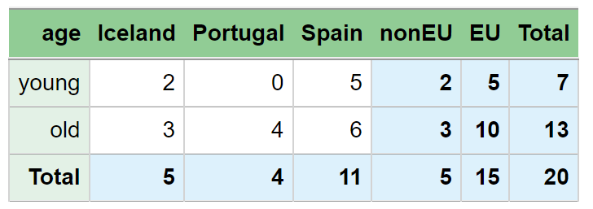
Frequency Data Input
That is, not the table(s) that are to be created
But an aggregated version of microdata
Instead of many identical rows in microdata
There is one row accompanied by a frequency value used as freqVar
We often refer to this as inner cells
Rows with frequency value=0 may or may not be included
NOTE
Frequency data input should not have rows that represent the sum of other rows
Input data should not look like output data
That is, no separate rows for totals
That is, no separate row for county if municipality is the lowest level
County codes are instead in a separate column
Similar to the EU column here

Slide 5
Codes or categories maybe missing in microdata
When no statistical unit has these codes
But maybe you want such codes in the output, with the value or frequency 0.

Slide 6
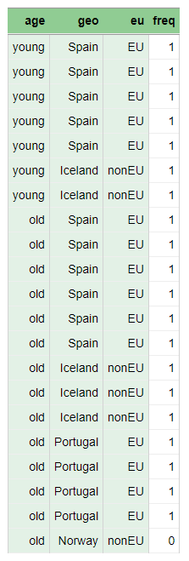
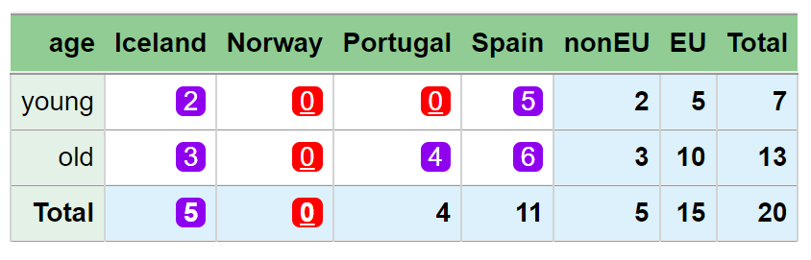

Trick when codes are missing in microdata
SuppressSmallCounts(data = dataset_c,
dimVar = c("age", "geo", "eu"),
freqVar = "freq",
maxN = 1,
preAggregate = TRUE)
[preAggregate 21*4->6*4]
[extend0 6*4->8*4]
GaussSuppression_anySum: .................
> Print(q)
age geo freq primary suppressed
1 Total Total 20 - -
2 Total EU 15 - -
3 Total nonEU 5 - -
4 Total Iceland 5 - TRUE
5 Total Norway 0 TRUE TRUE
6 Total Portugal 4 - -
7 Total Spain 11 - -
8 old Total 13 - -
9 old EU 10 - -
10 old nonEU 3 - -
11 old Iceland 3 - TRUE
12 old Norway 0 TRUE TRUE
13 old Portugal 4 - TRUE
14 old Spain 6 - TRUE
15 young Total 7 - -
16 young EU 5 - -
17 young nonEU 2 - -
18 young Iceland 2 - TRUE
19 young Norway 0 TRUE TRUE
20 young Portugal 0 TRUE TRUE
21 young Spain 5 - TRUE
Create a frequency variable in the microdata with 1’s
Add rows with 0 frequency that account for the missing codes
Use freqVar =
your new frequency variable
Use preAggregate = TRUE

Slide 7
Should you use preAggregate = TRUE ? - in frequency table suppression
Microdata
That is, freqVar is not specified
This issue is not relevant
preAggregate is needed to make a frequency variable
Frequency data
Changing from default to preAggregate = TRUE is a safe choice
0’s will not disappear during aggregation
If your data is not aggregated enough, the algorithm will run faster
But if data is already properly aggregated, unnecessary time will be spent on aggregation that does not result in change.

Slide 8
Advanced hierarchy examples which is also the preamble to structural 0’s
What does structural zero mean?

Slide 9
First about: output = "inner"
With the output parameter, you can obtain different outputs than usual
If you want to see how the function has altered the input data
Use output = "inner"
Then you receive data after automatic aggregation
And after using extend0
Will soon show some results from this
We have seen this in one magnitude table exercise
In magnitude tables we had preAggregate and extraAggregate
In frequency tables only preAggregate
which is important in frequency tables

Slide 10
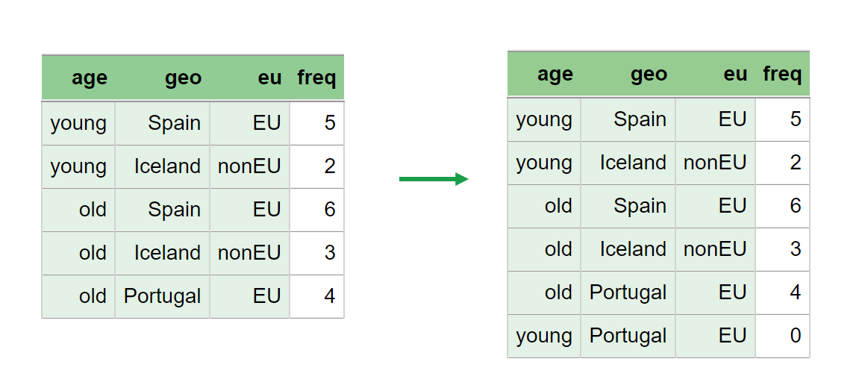
The row with freq = 0 can be omitted
> dataset_a5
age geo eu freq
1 young Spain EU 5
2 young Iceland nonEU 2
3 old Spain EU 6
4 old Iceland nonEU 3
5 old Portugal EU 4
> SuppressSmallCounts(data = dataset_a5,
dimVar = c("age", "geo", "eu"),
freqVar = "freq", maxN = 1)
[extend0 5*4->6*4]
GaussSuppression_anySum: .............
age geo freq primary suppressed
1 Total Total 20 - -
2 Total EU 15 - -
3 Total nonEU 5 - -
4 Total Iceland 5 - -
5 Total Portugal 4 - -
6 Total Spain 11 - -
7 old Total 13 - -
8 old EU 10 - -
9 old nonEU 3 - -
10 old Iceland 3 - -
11 old Portugal 4 - TRUE
12 old Spain 6 - TRUE
13 young Total 7 - -
14 young EU 5 - -
15 young nonEU 2 - -
16 young Iceland 2 - -
17 young Portugal 0 TRUE TRUE
18 young Spain 5 - TRUE
The answer remains the same
But not always …
This row with frequency 0 is added to the new ”inner” data
This is due to extend0

Slide 11
If you want to create a hierarchy manually
Earlier Slide
$age
mapsFrom mapsTo sign
1 old Total 1
2 young Total 1
$geo
mapsFrom mapsTo sign
1 EU Total 1
2 Portugal EU 1
3 Spain EU 1
4 nonEU Total 1
5 Iceland nonEU 1
mapsFrom | mapsTo | sign | level
EU | Total | 1 | 2
Portugal | EU | 1 | 1
Spain | EU | 1 | 1
nonEU | Total | 1 | 2
Iceland | nonEU | 1 | 1
The level column can be removed
The sign column should only have 1s
The possibility for -1 is designed for purposes other than suppression

Slide 12
Example of modified hierarchy
> hi3 <- FindHierarchies(dataset_a[c("age", "geo", "eu")])
> hi3
$age
mapsFrom mapsTo sign level
1 old Total 1 1
2 young Total 1 1
$geo
mapsFrom mapsTo sign level
1 EU Total 1 2
2 Portugal EU 1 1
3 Spain EU 1 1
4 nonEU Total 1 2
5 Iceland nonEU 1 1
Removing the level column before the code on the next slide

Slide 13
Example of modified hierarchy
> hib <- hi3
> hib[["geo"]] <- hib[["geo"]][c(1:5, 5, 5), ]
> hib[["geo"]][6, "mapsFrom"] <- "Norway"
> hib[["geo"]][7, "mapsFrom"] <- "Asia"
> hib[["geo"]][7, "mapsTo"] <- "Total"
> rownames(hib[["geo"]]) <- NULL
> hib
$age
mapsFrom mapsTo sign
1 old Total 1
2 young Total 1
$geo
mapsFrom mapsTo sign
1 EU Total 1
2 Portugal EU 1
3 Spain EU 1
4 nonEU Total 1
5 Iceland nonEU 1
6 Norway nonEU 1
7 Asia Total 1
Not necessary, but rownames in a classic data.frame are annoying.
Here we add Norway and Asia as new codes
Norway a new non-EU country
Perfectly okay that Asia does not have “children”

Slide 14
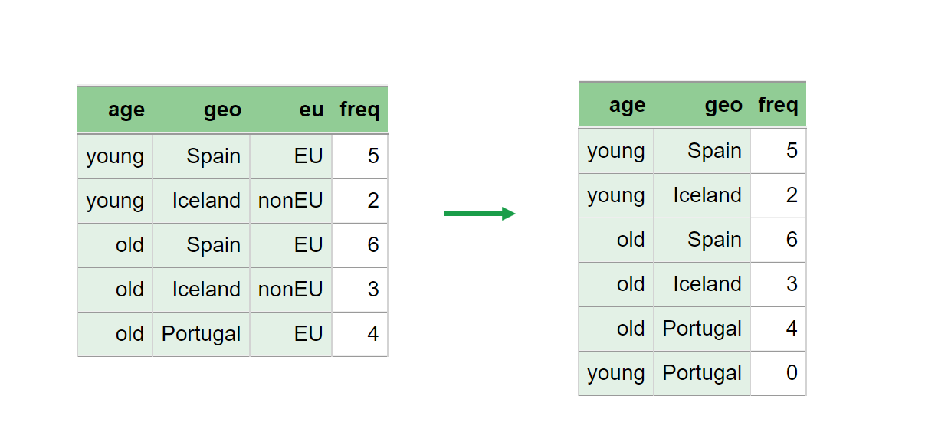
Example with modified hierarchy
This row with frequency 0 is added to the new ”inner” data
This is because this combination is missing in input
This is due to extend0
But Norway and Asia are not added
age geo freq primary suppressed
1 Total Total 20 - -
2 Total EU 15 - -
3 Total nonEU 5 - -
4 Total Asia 0 TRUE TRUE
5 Total Iceland 5 - -
6 Total Norway 0 TRUE TRUE
7 Total Portugal 4 - -
8 Total Spain 11 - -
9 old Total 13 - -
10 old EU 10 - -
11 old nonEU 3 - -
12 old Asia 0 TRUE TRUE
13 old Iceland 3 - -
14 old Norway 0 TRUE TRUE
15 old Portugal 4 - TRUE
16 old Spain 6 - TRUE
17 young Total 7 - -
18 young EU 5 - -
19 young nonEU 2 - -
20 young Asia 0 TRUE TRUE
21 young Iceland 2 - -
22 young Norway 0 TRUE TRUE
23 young Portugal 0 TRUE TRUE
24 young Spain 5 - TRUE
SuppressSmallCounts(data = dataset_a5,
hierarchies = hib,
freqVar = "freq", maxN = 1)
[extend0 5*3->6*3]
GaussSuppression_anySum: ..............
Warning message:
In GaussSuppression(x = x, candidates = candidates, primary = primary, :
Suppressed cells with empty input will not be protected. Extend input data with zeros?
We see a warning about possible problems
Norway and Asia are included
Primary suppressed
But can easily be revealed
Although we have the correct singleton method
Do you see how?

Slide 15
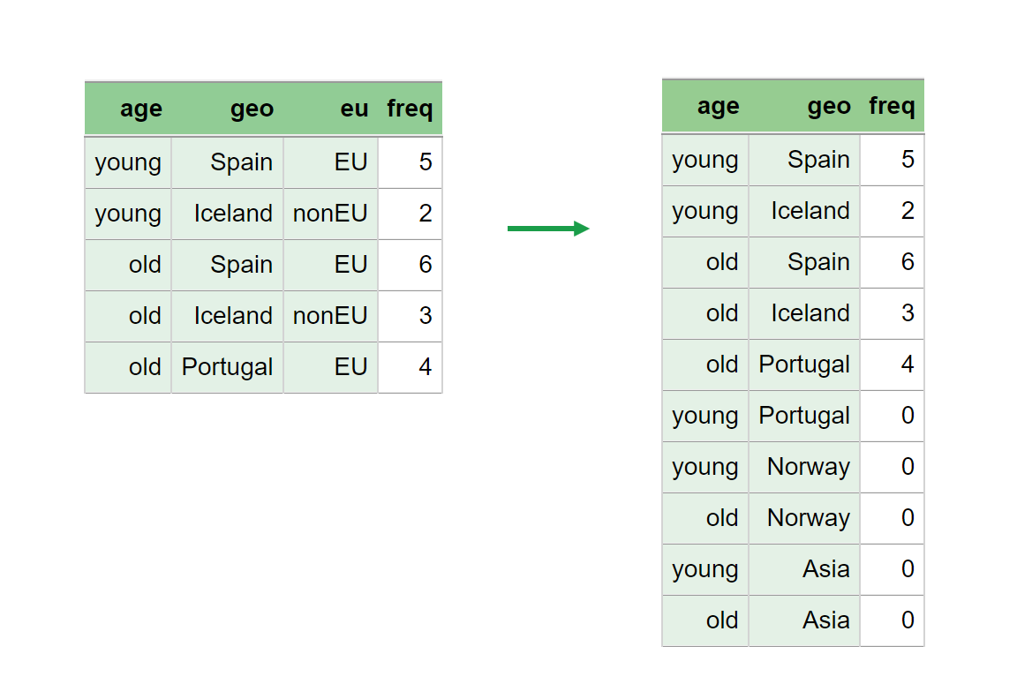
Example with modified hierarchy
Now, several rows with frequency 0 are added to the new ”inner” data
Now, Norway and Asia are also added
This is due to extend0 = "all"
age geo freq primary suppressed
1 Total Total 20 - -
2 Total EU 15 - -
3 Total nonEU 5 - -
4 Total Asia 0 TRUE TRUE
5 Total Iceland 5 - -
6 Total Norway 0 TRUE TRUE
7 Total Portugal 4 - -
8 Total Spain 11 - -
9 old Total 13 - -
10 old EU 10 - -
11 old nonEU 3 - -
12 old Asia 0 TRUE TRUE
13 old Iceland 3 - -
14 old Norway 0 TRUE TRUE
15 old Portugal 4 - TRUE
16 old Spain 6 - TRUE
17 young Total 7 - -
18 young EU 5 - -
19 young nonEU 2 - -
20 young Asia 0 TRUE TRUE
21 young Iceland 2 - -
22 young Norway 0 TRUE TRUE
23 young Portugal 0 TRUE TRUE
24 young Spain 5 - TRUE
SuppressSmallCounts(data = dataset_a5,
hierarchies = hib,
freqVar = "freq", maxN = 1,
extend0 = "all")
[extend0 5*3->10*3]
GaussSuppression_anySum: ..............
Norway and Asia are included
Primary suppressed and protected
extend0 = TRUE
This is the default
Extends data internally with zeros based on what is already in the data
extend0 = "all"
Extends with zeros based on the hierarchy as well

Slide 16
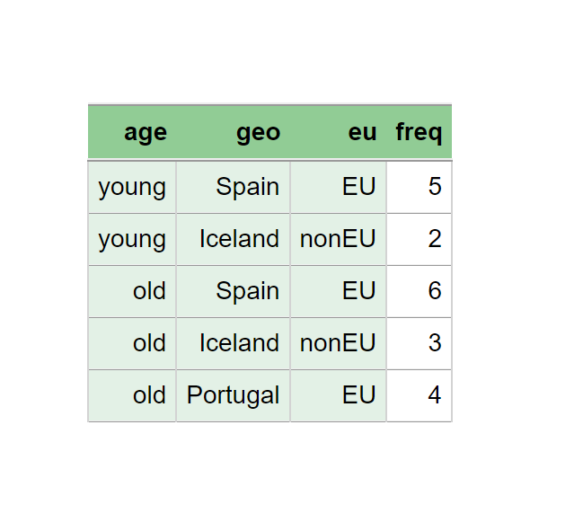
Example with modified hierarchy
age geo freq primary suppressed
1 Total Total 20 - -
2 Total EU 15 - -
3 Total nonEU 5 - -
4 Total Asia 0 TRUE TRUE
5 Total Iceland 5 - -
6 Total Norway 0 TRUE TRUE
7 Total Portugal 4 - -
8 Total Spain 11 - -
9 old Total 13 - -
10 old EU 10 - -
11 old nonEU 3 - -
12 old Asia 0 TRUE TRUE
13 old Iceland 3 - -
14 old Norway 0 TRUE TRUE
15 old Portugal 4 - -
16 old Spain 6 - -
17 young Total 7 - -
18 young EU 5 - -
19 young nonEU 2 - -
20 young Asia 0 TRUE TRUE
21 young Iceland 2 - -
22 young Norway 0 TRUE TRUE
23 young Portugal 0 TRUE TRUE
24 young Spain 5 - -
SuppressSmallCounts(data = dataset_a5,
hierarchies = hib,
freqVar = "freq", maxN = 1,
extend0 = FALSE))
GaussSuppression_anySum: ..............
Warning message:
In GaussSuppression(x = x, candidates = candidates, primary = primary, :
Suppressed cells with empty input will not be protected. Extend input data with zeros?
extend0 = FALSE
No extension of data
Here, no zeros are protected

Slide 17
Example with modified hierarchy
Norway and Asia no longer primary suppressed
Now again extend0
without Norway and Asia being added
age geo freq primary suppressed
1 Total Total 20 - -
2 Total EU 15 - -
3 Total nonEU 5 - -
4 Total Asia 0 - -
5 Total Iceland 5 - -
6 Total Norway 0 - -
7 Total Portugal 4 - -
8 Total Spain 11 - -
9 old Total 13 - -
10 old EU 10 - -
11 old nonEU 3 - -
12 old Asia 0 - -
13 old Iceland 3 - -
14 old Norway 0 - -
15 old Portugal 4 - TRUE
16 old Spain 6 - TRUE
17 young Total 7 - -
18 young EU 5 - -
19 young nonEU 2 - -
20 young Asia 0 - -
21 young Iceland 2 - -
22 young Norway 0 - -
23 young Portugal 0 TRUE TRUE
24 young Spain 5 - TRUE
SuppressSmallCounts(data = dataset_a5,
hierarchies = hib,
freqVar = "freq", maxN = 1,
structuralEmpty = TRUE)
[extend0 5*3->6*3]
GaussSuppression_anySum: ..............
Now, no warning and no problem. Since …
structuralEmpty = TRUE
Means that zeros not related to the dataset are considered structural zeros
These are not primary suppressed
Nor can they be secondary suppressed

Slide 18
Structural Zeros
These are zeros that are publicly known, due to the nature and limitations of the variables involved.
Examples
Number of one-year-olds with higher education
The number of Teslas produced in 2005
Since the production started in 2008
Structural Zeros
Must never be primary suppressed
Also must never be secondary suppressed

Slide 19
Back to formula
age geo freq primary suppressed
1 Total Total 20 - -
2 old Total 13 - -
3 young Total 7 - -
4 Total Iceland 5 - -
5 Total Portugal 4 - -
6 Total Spain 11 - -
7 Total EU 15 - -
8 Total nonEU 5 - -
9 old Iceland 3 - TRUE
10 old Portugal 4 - TRUE
11 old Spain 6 - -
12 young Iceland 2 TRUE TRUE
13 young Portugal 0 TRUE TRUE
14 young Spain 5 - -
15 old EU 10 - TRUE
16 old nonEU 3 - TRUE
17 young EU 5 - TRUE
18 young nonEU 2 TRUE TRUE
SuppressSmallCounts(data = dataset_a5,
formula = ~age * (geo + eu),
freqVar = "freq", maxN = 2)
[extend0 5*4->6*4]
GaussSuppression_anySum: .............
The same occurs via the formula interface
Necessary variables are included

Slide 20
Theory What happens from input to output? And what does “empty” output mean?
Actually: What happens from modified input to output?

Slide 21
Simple formula and original dataset
SuppressSmallCounts(data = dataset_a,
formula = ~age * eu,
freqVar = "freq", maxN = 2)
[extend0 6*3->6*3]
GaussSuppression_anySum: ........
age eu freq primary suppressed
1 Total Total 20 - -
2 old Total 13 - -
3 young Total 7 - -
4 Total EU 15 - -
5 Total nonEU 5 - -
6 old EU 10 - TRUE
7 old nonEU 3 - TRUE
8 young EU 5 - TRUE
9 young nonEU 2 TRUE TRUE
Input
age geo eu freq
1 young Spain EU 5
2 young Iceland nonEU 2
3 young Portugal EU 0
4 old Spain EU 6
5 old Iceland nonEU 3
6 old Portugal EU 4
Output
age geo freq
1 Total Total 20
2 old Total 13
3 young Total 7
4 Total EU 15
5 Total nonEU 5
6 old EU 10
7 old nonEU 3
8 young EU 5
9 young nonEU 2

Slide 22
How does calculation from input to output occur?
Input
age geo eu freq
1 young Spain EU 5
2 young Iceland nonEU 2
3 young Portugal EU 0
4 old Spain EU 6
5 old Iceland nonEU 3
6 old Portugal EU 4
Output
age geo freq
1 Total Total 20
2 old Total 13
3 young Total 7
4 Total EU 15
5 Total nonEU 5
6 old EU 10
7 old nonEU 3
8 young EU 5
9 young nonEU 2
In the same way regardless of whether there are hierarchies, formulas or many strange parameters.
It happens through a matrix

Slide 23
How does calculation from input to output occur?
Input
age geo eu freq
1 young Spain EU 5
2 young Iceland nonEU 2
3 young Portugal EU 0
4 old Spain EU 6
5 old Iceland nonEU 3
6 old Portugal EU 4
freq
5
2
0
6
3
4
Output
age geo freq
1 Total Total 20
2 old Total 13
3 young Total 7
4 Total EU 15
5 Total nonEU 5
6 old EU 10
7 old nonEU 3
8 young EU 5
9 young nonEU 2
freq
20
13
7
15
5
10
3
5
2

Slide 24
Input
age geo eu freq
1 young Spain EU 5
2 young Iceland nonEU 2
3 young Portugal EU 0
4 old Spain EU 6
5 old Iceland nonEU 3
6 old Portugal EU 4
This is called a matrix
In this context, there should only be zeros and ones
Often rows and columns are switched
This can also be viewed as a nice feature that can be used for structural 0’s.
Structural 0’s are not included in the input data
Other 0’s are included
The number of columns in this matrix = the number of rows in the input
No information about the input frequency value in the matrix
But it may be that a zero in the output can be determined solely from the matrix
If all elements in a row are zero, then the answer must be zero
This is what is meant by "empty" in the parameter name
The Gauss algorithm takes such a matrix as a starting point
The algorithm cannot protect a primary suppressed zero when the row is empty
The algorithm will also never secondary suppress an empty row
The algorithm depends on extending data by including relevant zeros
Output
age geo freq
1 Total Total 20
2 old Total 13
3 young Total 7
4 Total EU 15
5 Total nonEU 5
6 old EU 10
7 old nonEU 3
8 young EU 5
9 young nonEU
freq
20
13
7
15
5
10
3
5
2
1 1 1 1 1 1
. . . 1 1 1
1 1 1 . . .
1 . 1 1 . 1
. 1 . . 1 .
. . . 1 . 1
. . . . 1 .
1 . 1 . . .
. 1 . . . .
freq
5
2
0
6
3
4
=
×
“.” means “0”

Slide 25
How to determine when the output is “empty”?
Option 1: Look at the matrix
Are there only 0’s in a row/column contributing to the number?
Option 2: Think
Will the answer be 0 regardless of the values in the frequency variable?

Slide 26
A difference between the hierarchy and formula interface
Earlier Slide
removeEmpty

Slide 27
The removeEmpty parameter
Earlier Slide
Determines whether combinations that have no contribution from input should be included in the output
Default:
TRUE in the formula interface
FALSE in the hierarchy interface and for dimVar
But always possible to specify it manually

Slide 28
About automatic aggregation

Slide 29
Simple formula
SuppressSmallCounts(data = dataset_a5,
formula = ~age * eu,
freqVar = "freq", maxN = 2)
[extend0 5*3->5*3]
GaussSuppression_anySum: ........
age eu freq primary suppressed
1 Total Total 20 - -
2 old Total 13 - -
3 young Total 7 - -
4 Total EU 15 - -
5 Total nonEU 5 - -
6 old EU 10 - TRUE
7 old nonEU 3 - TRUE
8 young EU 5 - TRUE
9 young nonEU 2 TRUE TRUE

Slide 30
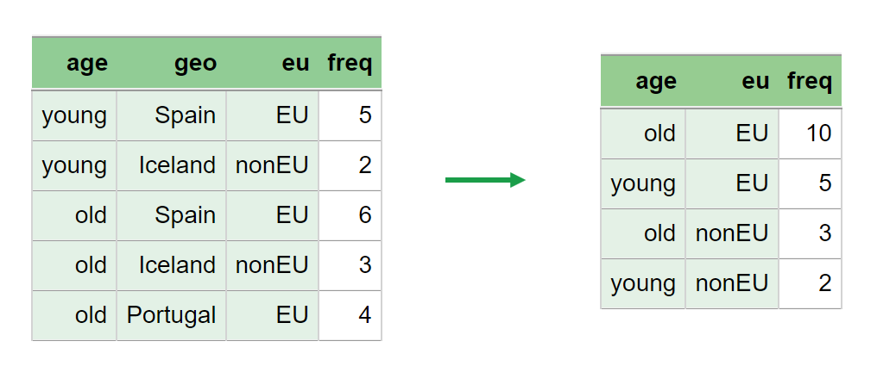
Simple formula and preAggregate = TRUE
SuppressSmallCounts(data = dataset_a5,
formula = ~age * eu,
freqVar = "freq", maxN = 2,
preAggregate = TRUE)
[preAggregate 5*4->4*3]
[extend0 4*3->4*3]
age eu freq primary suppressed
1 Total Total 20 - -
2 old Total 13 - -
3 young Total 7 - -
4 Total EU 15 - -
5 Total nonEU 5 - -
6 old EU 10 - TRUE
7 old nonEU 3 - TRUE
8 young EU 5 - TRUE
9 young nonEU 2 TRUE TRUE
Exactly the same output
But internally a bit different
preAggregate
TRUE default when freqVar is not included (microdata)
FALSE default when freqVar is included

Slide 31
Microdata
sosial[["freq"]] <- 1
aggregate(sosial["freq"],
sosial[c("fylkesnavn", "navn", "kostragr", "hovedint", "mnd")],
sum)
fylkesnavn navn kostragr hovedint mnd freq
1 Trondelag Frosta 1 annet m01m05 23
2 Viken Marker 1 annet m01m05 8
3 Trondelag Oppdal 1 annet m01m05 7
4 Viken Sarpsborg 1 annet m01m05 2
5 Trondelag Selbu 1 annet m01m05 6
6 Trondelag Skaun 1 annet m01m05 9
7 Trondelag Steinkjer 1 annet m01m05 3
8 Viken Ullensaker 2 annet m01m05 1
9 Viken Drammen 3 annet m01m05 1
10 Trondelag Malvik 3 annet m01m05 2
11 Trondelag Osen 3 annet m01m05 1
12 Trondelag Frosta 1 arbeid m01m05 14
13 Viken Marker 1 arbeid m01m05 13
14 Trondelag Oppdal 1 arbeid m01m05 8
15 Viken Sarpsborg 1 arbeid m01m05 11
16 Trondelag Selbu 1 arbeid m01m05 5
17 Trondelag Skaun 1 arbeid m01m05 6
18 Trondelag Steinkjer 1 arbeid m01m05 1
19 Viken Drammen 3 arbeid m01m05 1
: : : : : : :
Many ways to aggregate in R
Aggregation occurs automatically in GaussSuppression functions
Rows with frequency=0 are then excluded
Extend0 is absolutely necessary when 0’s are suppressed

Slide 32
Structural Zeros Key lessons for formula interface users

Slide 33
Structural 0’s Option 1: Use frequency data input
Create frequency data yourself by aggregating microdata
Add rows with 0 frequency
Rows with 0 frequency should represent 0’s that could have been something other than 0
That is, not structural 0’s.
Use the parameters: structuralEmpty = TRUE, extend0 = FALSE
If you want structural 0’s in output: removeEmpty = FALSE

Slide 34
Structural 0’s Option 2: Modified microdata input
Create a frequency variable in microdata with 1's
Add rows with 0 frequency
The rows with 0 frequency should represent 0’s that could have been something other than 0
That is, not structural 0’s
Do it in such a way that aggregation will yield the same result as Option 1
Use the parameters: structuralEmpty = TRUE, extend0 = FALSE, preAggregate = TRUE, freqVar = your new frequency variable
If you want structural 0’s in output: removeEmpty = FALSE

Slide 35
Structural 0’s Option 3: Learn more + microdata input
Learn about more possibilities with the extend0 parameter
Use the parameter: structuralEmpty = TRUE
If you want structural 0’s in output: removeEmpty = FALSE

Slide 36
No primary suppression of any zeros?
Possible but not recommended
It can be done with protectZeros = FALSE
That is, 0’s are not primary suppressed
Then one can also use secondaryZeros = TRUE
That is, 0’s can be secondary suppressed

Slide 37
Exercises, frequency tables (this presentation)
exercises/structural_zeros.md
Direct link:
https://github.com/statisticsnorway/kurs-metode-sdc-2024/blob/main/exercises/structural_zeros.md
Exercises, SmallCountRounding (next presentation)
exercises/small_count_rounding.md
Direct link:
https://github.com/statisticsnorway/kurs-metode-sdc-2024/blob/main/exercises/small_count_rounding.md

